Slide 1

Group 7
Sathi
Vamshi
Chung-Min Chen
Piyush
Aseem

Slide 2
Our Business
The nation’s leading Fabric and Craft retailer for nearly 75 years
865 stores across 49 states and an leading e-commerce business

Slide 3

Our Goal
Increase Revenue
Our Strategy
Customer segmentation based on product choice
Elasticity and Market Basket Analysis
Focus on the top revenue contributing products in each segment
Increase/decrease price of the products to increase total revenue
Test and learn plan

Slide 4


Executive Summary
Current revenue from 21 significant product categories: $811,000 (Approx.)
Recommendation – Increase price by 15% as per products price sensitivity
Implementing our recommendations will lead to 10.4% increase in the revenue – which is approximately $78,000

Slide 5
Our Customers
6. Delightful Decorators
1. Favorite Fans
Our Customers
5. Joyous Jewels
2. Cozy Comforters
4. Season Seekers
3. Crafty Crafters

Slide 6
Favorite Fans
Special, Warm, Fabric, Seasonal Flower, Quilt, Sew, Ribbon
15%
Customers
30% of total products sold
30%
of total revenue
→ Highest Revenue → We are their favorite Store! → Receive highest # Mails

Slide 7
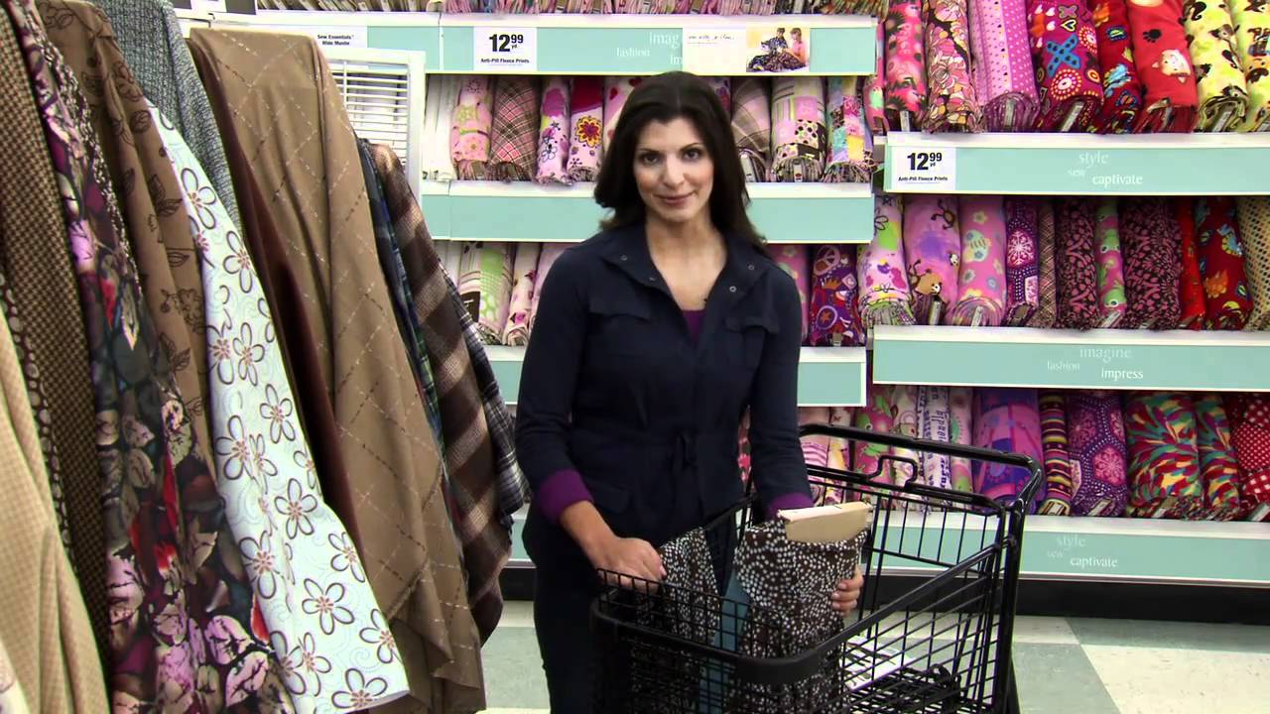

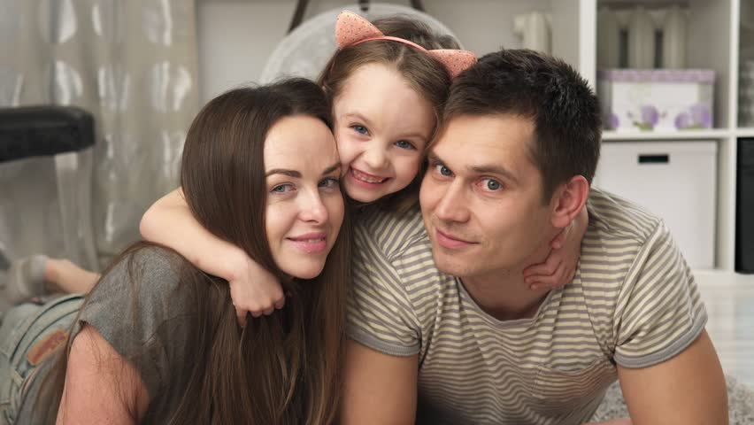

Our Recommendations for Favorite Fans
Increase Product prices by 15% Special, Warm, Fabric, Seasonal Flower, Quilt, Sew, Ribbon
01
Market Basket Analysis Bundle Fabric with Quilt and Sew
02
Revenue Increase Segment revenue increase by 12.5%
Amount $15,000
03
Overall revenue increase $37,000

Slide 8
Favorite Fans - Financial Impact and MBA
Elasticity Analysis
MBA
Product | Change in Revenue % | Revenue Change
Special | 13.72% | 1518
Warm | 12.52% | 1405
Fabric | 10.48% | 1875
Seasonal | 13.86% | 839
Quilt | 13.51% | 4134
Sew | 13.96% | 4867
 | Special | Warm | Fabric | Seasfloral | Quilt | Public | Sew
Special |  |  | 103.3 | -59.5
Warm |  |  | 78.6 |  |  |  | 52.6
Fabric | 101.3 | 77.8 |  |  | 118.5 |  | 224.1
Seasfloral | -59.5
Quilt |  | 43.9 | 121.9 |  |  | 85.4 | 86.3
Public |  |  |  |  | 82.4
Sew |  |  | 243.5 |  | 102.1

Slide 9
Cozy Comforters
Fleece, Needle, Warm, Foam, Quilt
21%
Customers
14% of total products sold
16%
of total revenue
→ Second Largest Segment → Marketing mostly through Emails

Slide 10
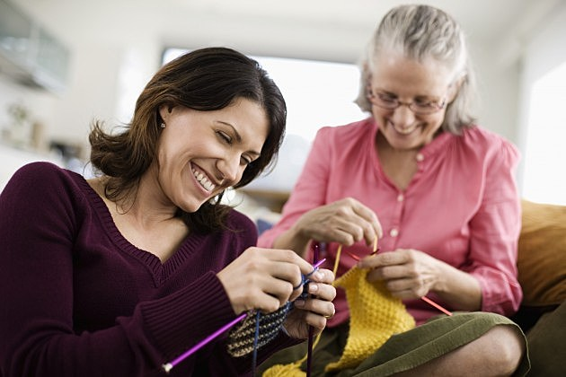
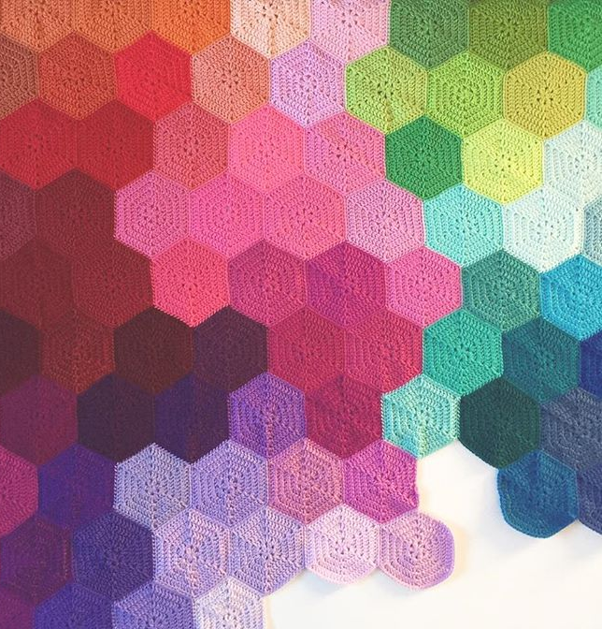
Our Recommendations for Cozy Comforters
Increase Product prices by 15% Fleece, Needle, Warm, Quilt
01
02
Decrease Product price by 5% - Foam
Market Basket Analysis Bundle Quilt with Warm, Quilt with Sew,
Needle with Public
03
Revenue Increase Segment revenue increase by 11%
04
Overall revenue increase $25,000

Slide 11
Cozy Comforters - Financial Impact and MBA
Elasticity Analysis
MBA
Product | Change in Revenue % | Revenue Change
fleece | 10.22% | 1365
needle | 13.99% | 3116
warm | 12.16% | 945
foam | -0.07% | -5
quilt | 11.90% | 2028
 | fleece | needle | warm | foam | quilt | public | sew
fleece |  | -96 | -87.9 |  |  | -1.6
needle | -96.2 |  | -95.2 |  |  | 403 | 49.9
warm | -83.9 | -93.5 |  | 91.4 | 269.3 |  | 61
foam |  |  | 88.7 |  | 177.1 |  | 80
quilt |  |  | 302.9 | 179.3 |  |  | 283.9
public |  | 252.5 |  | 61
sew |  | 60.6 | 79.2 | 77.6 | 283.6

Slide 12
Crafty Crafters
Paper, Paper Craft, Jewelry
13.5% Customers
28% of total products sold
26%
of total revenue
→ Second highest revenue Segment → Marketing through all channels

Slide 13
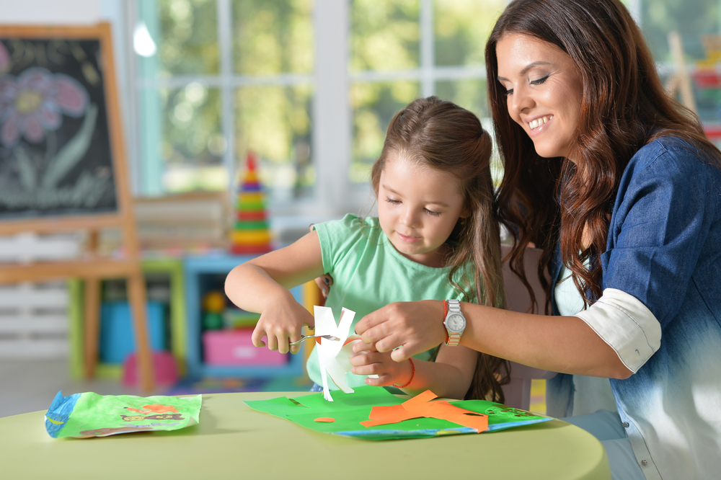
Our Recommendations for Crafty Crafters
Increase Product prices by 15% Paper, Paper Craft, Jewelry, Fleece
01
Market Basket Analysis Bundle Paper with Paint, Jewelry with Bccomp
02
Revenue Increase Segment revenue increase by 12%
Amount $6,500
03
Overall revenue increase $8,800

Slide 14
Crafty Crafters - Financial Impact and MBA
Elasticity Analysis
MBA
Product | Change in Revenue % | Revenue Change
pct | 9.29% | 1389
paper | 14.88% | 3232
jewelry | 12.60% | 1018
fleece | 8.29% | 933
 | Pct | Paper | Jewelry | Fleece | Warm | Bccomp | Celeb | Paint
Pct |  |  |  | -51.8 | -39.1 | 54.8
Paper |  |  | -59.7 | -34.9 |  | 88.5 |  | 293.1
Jewelry |  | -60.4 |  |  |  | 183.3 |  | 79.8
Fleece | -51.5 | -35.9 |  |  | 63.5 | 99.8 | 62.3
Warm | -39.1 |  |  | 64.1 |  |  | 106.3
Bccomp | 51.0 | 92.6 | 183.1 | 99.5 |  |  | 104.4 | 154.0
Celeb |  |  |  | 65.1 | 107.9 | 105.3 |  | 67.7
Paint |  | 312.5 | 84 |  |  | 154.6 | 69.9

Slide 15
Season Seekers
Seasonal Flowers, Paint, Kids
14.4% Customers
12.5% of total products sold
11%
of total revenue
→ Love various seasonal products → Second lowest revenue segment

Slide 16

Our Recommendations for Season Seekers
Increase Product prices by 15% Seasonal Flowers, Paint, Kids
01
Market Basket Analysis Bundle Flowers with Ribbon, Kids products with Impulse products, Needle with Jewelry
02
03
Revenue Increase Segment revenue increase by 9%
Overall revenue increase $6,000

Slide 17
Season Seekers - Financial Impact and MBA
Elasticity Analysis
MBA
Product | Change in Revenue % | Revenue Change
Seasfloral | 8.08% | 513
Paint | 9.71% | 532
Kids | 8.63% | 353
 | Seasfloral | Paint | Kids | Paper | Jewelry | Bccomp | Ribbon | Impulse
Seasfloral |  |  |  | -98.2 | -66.0 | 97.9 | 188.1
Paint |  |  |  | 75.6 |  | 136.9 | 77.8
Kids |  |  |  | 70.3 |  | 65.2 |  | 132.9
Paper | -98.1 | 80.4 | 74.2 |  | -62.1 | 164.4 | 86.8 | 84.1
Jewelry | -63.8 |  |  | -58.1 |  | 107.8 | 64.4
Bccomp | 81.8 | 135.6 | 63.6 | 157.9 | 109.7 |  | 54.4 | 82.7
Ribbon | 150.7 | 76.3 |  | 94.4 | 60.6 | 54.5 |  | 65.4
Impulse |  |  | 129.9 | 98.8 | 0.0 | 82.3 | 66.0

Slide 18
Joyous Jewels
Jewelry and Specials
10%
Customers
7.5% of total products sold
8%
of total revenue
→ Smallest segment → Lowest revenue segment

Slide 19

Our Recommendations for Joyous Jewels
Increase Product prices by 15% Jewelry and Specials
01
Market Basket Analysis Bundle Jewelry with Bccomp,
Jewelry with Fabric
02
03
Revenue Increase Segment revenue increase by 14%
Overall revenue increase $4,500

Slide 20
Joyous Jewels - Financial Impact and MBA
Elasticity Analysis
MBA
Product | Change in Revenue % | Revenue Change
special | 14.32% | 1027
jewelry | 13.51% | 1021
 | Special | Jewelry | Fabric | Homedec | Sew | Bccomp | Quilt
Special |  |  |  |  | 208.5 | 94.0
Jewelry | -99.9 | -100.0 | 267.1 |  |  | 247.1
Fabric | 265.6 |  | 0.0 | 150.5 | 191.9 |  | 98.0
Homedec |  |  | 150.6 |  |  | 139.7 | 203.9
Sew | 197.8 |  | 196.4 |  |  |  | 234.7
Bccomp |  | 301.1 |  | 139.6
Quilt |  |  | 104.2 | 206.0 | 239.8

Slide 21
Delightful Decorators
Home Décor, Celebration, Foam
26.7% Customers
7.2% of total products sold
9% of total revenue
→ Largest segment → Low contribution to revenue

Slide 22
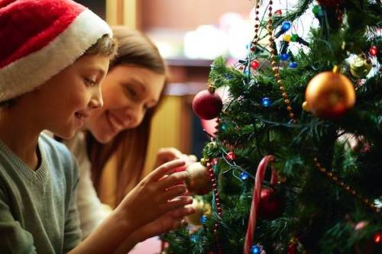
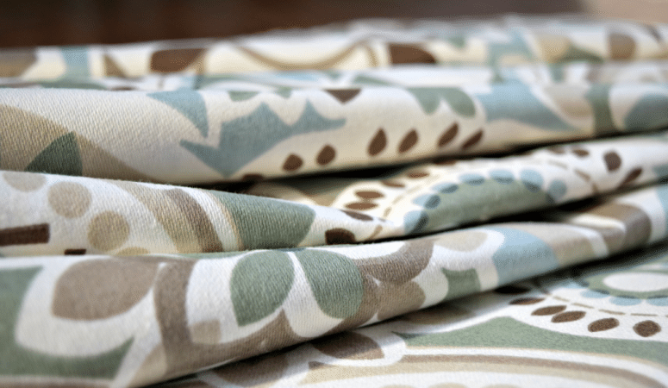
Our Recommendations for Delightful Decorators
Increase Product prices by 15% Home décor and Celebration
01
02
Decrease Product prices by 5% - Foam
Market Basket Analysis Bundle home décor with Foam
Bundle Celebrations with Ribbon
03
04
Revenue Increase Segment revenue increase by 5%
Overall revenue increase $3000

Slide 23
Delightful Decorators - Financial Impact and MBA
Elasticity Analysis
MBA
Product | Change in Revenue % | Revenue Change
homedec | 5.36% | 533
Celeb | 10.36% | 251
foam | -0.06% | -3
 | HOMEDEC | CELEB | FOAM | PAINT | SEW | QUILT | FABRIC | RIBBON
HOMEDEC |  | -51.8 | 106.1 |  |  |  |  | -8.9
CELEB | -52.6 |  |  |  |  | -41.4 |  | 103.1
FOAM | 112.3 |  |  |  | 44.9 | 120.9 |  | -50.1
PAINT |  |  |  |  | -43.1 | -42.8 |  | 10.3
SEW |  |  |  | -43.3 |  | 85.2 | 184.2 | 8.4
QUILT |  | -42.7 | 116.2 | -44.7 | 85.2 |  | 93.7 | -16.2
FABRIC |  |  |  |  | 185.6 | 95.6 |  | 5.2
RIBBON |  |  |  |  |  |  |  | 83.1

Slide 24
Financial Implications
Overall revenue increase by 10.4% accounting for ~$85,000

Slide 25

Test and Learn Plan
Build marketing strategy as per our recommendations
Run test trials on small group of customers
Measure performance both customer satisfaction and revenue
Analyze and Improve

Slide 26


